Slide 1
Chapter- 8 (HUMAN HEALTH AND DISEASE)
PART 2

Slide 2
VIRAL DISEASES
A viral disease (viral infection) occurs when an organism’s body is invaded by pathogenic viruses, and infectious virus particles.
Common cold
It is caused by rhonoviruses.
It infects the nose and respiratory tract but not the lungs.

Slide 3
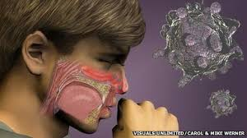
Symptoms:
Common cold is characterized by nasal congestion and discharge , sore throat and cough.
Headache , tiredness and fever may follow.
Usually last for 3-7 days.

Slide 4
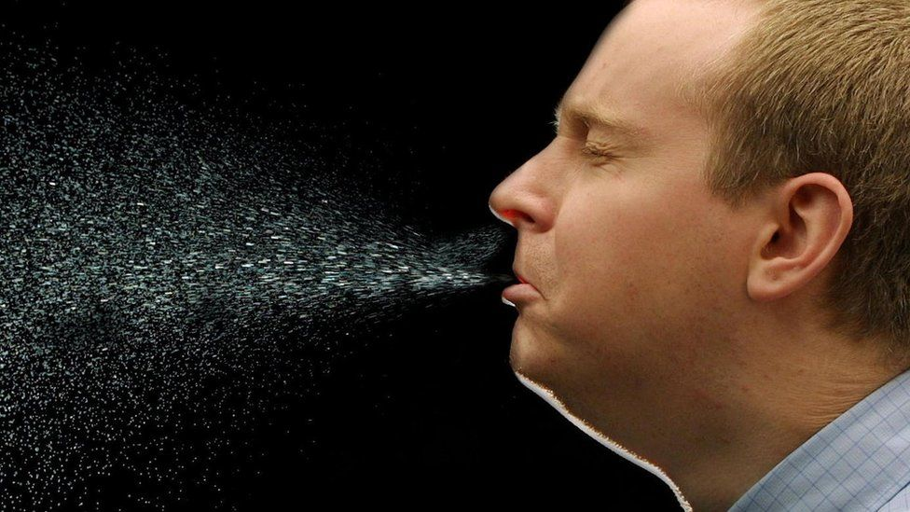
Mode of infections
Droplets resulting from cough or sneeze of an infected person through contaminated objects like pens, books ,cups ,doorknobs , computer keyboards etc cause infection in a healthy person

Slide 5
2. Chikungunya
Chikungunya is a viral disease that is transmitted in humans by the bite of infected Aedes aegypti mosquitoes.
Initial symptoms are similar to dengue (joint pain, headache and fever)
It is usually not life threatening but the joint pains can last for a very long time and full recovery may take months.
Re-infection/re-occurance of this disease in very rare(life long immunity)

Slide 6
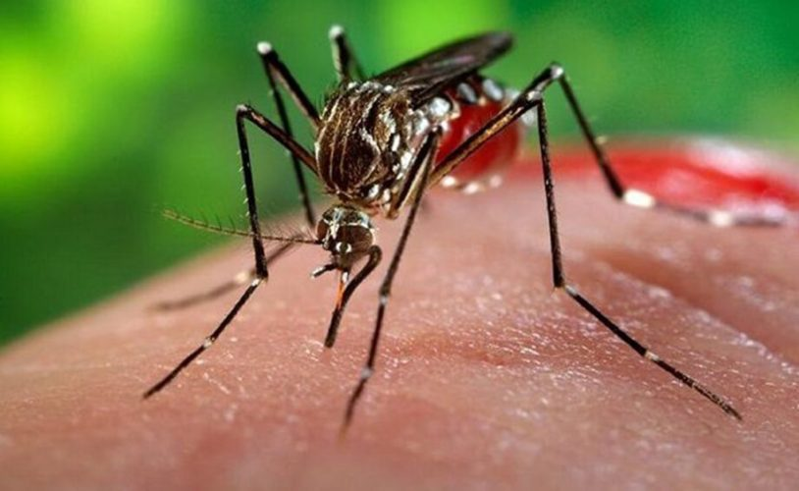
Symptoms:
Chills and high fever
Vomiting and nausea
Headache
Persistent joint pain
Spread : Chikungunya disease is a viral disease that spreads by the bite of infected Aedes aegypti mosquito. Aedes mosquitoes thrives well in the clean stale water present in vases, coolers, pots or pools in and around the houses.

Slide 7
Treatment
There is no treatment as there is no antiviral drug or medicine .
Paracetomol is given to relieve the pain and reduce fever.
Aspirin should be avoided.
Currently there is no vaccine for chikungunya. The only way to prevent chikungunya is to avoid mosquito bites.

Slide 8
3.Dengue
This is also known as “breakone” or “dandy fever”.(because of intense muscle and joint pain)
It’s a haemorrhagic fever and can be life-threatening or fatal.
A virus itself cannot spread through person to person and thus require a vector. The transmission of dengue virus occur by the bite of Aedes aegypti mosquito.

Slide 9
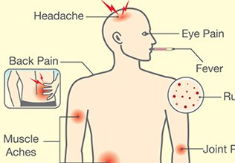
Symptoms
Abrupt onset of high fever.
Severe headache , muscle and joint pain.
Rash
Fall in blood platelet count.
Vomiting and abdominal pain
Bleeding nose and gums.

Slide 10
Prevention of dengue
Currently there is no vaccine available .Best precaution for dengue is the prevention from mosquito bites
Wear full sleeve shirts and pants
Spray fumigant in open drains and do not allow standing water in flower pots, coolers etc
Use insect repellent containing oil of eucalyptus or lemon on exposed skin

Slide 11
Thank you

