Slide 1
SEXUAL REPRODUCTION IN FLOWERING PLANT
BIOLOGY

Slide 2
TOPICS
Seeds( Types, advantages)
Unusual features of Sexual Reproduction

Slide 3
SEEDS
A seed can be defined as a mature fertilised ovule that possess an embryo , stored food material in the cotyledons or endosperm and a protective coat.
An ovule undergoes a series of changes after fertilisation, as a result of which seed is formed.
The two integument develop into the two seed coats.
The egg cell grows into an embryo.
The triploid nucleus gives rise to the endosperm.

Slide 4
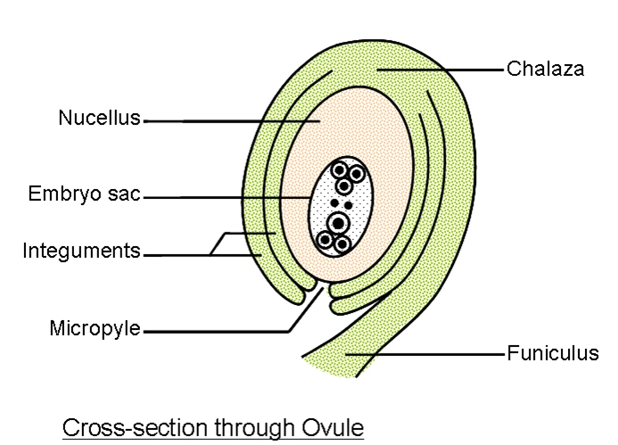
Transformation of ovule into seed
OVULE
SEED

Slide 5
Types of seeds
Based on the presence or absence of the endosperm.
Endospermic seeds
Non-endospermic seeds
Based on the number of cotyledons.
Monocotyledons seeds
Dicotyledonous seeds

Slide 6
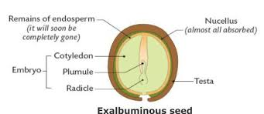
1.Based on the presence or absence of the endosperm
Endospermic or albuminous seeds:
They contain endosperm as stored food while the cotyledons are small, thin and papery. The endosperm formed in the early stages is not exhausted by the developing embryo and endosperm continues to store food and grow vigorously.
Example:- coconut , rice, maize ,castor bean.

Slide 7
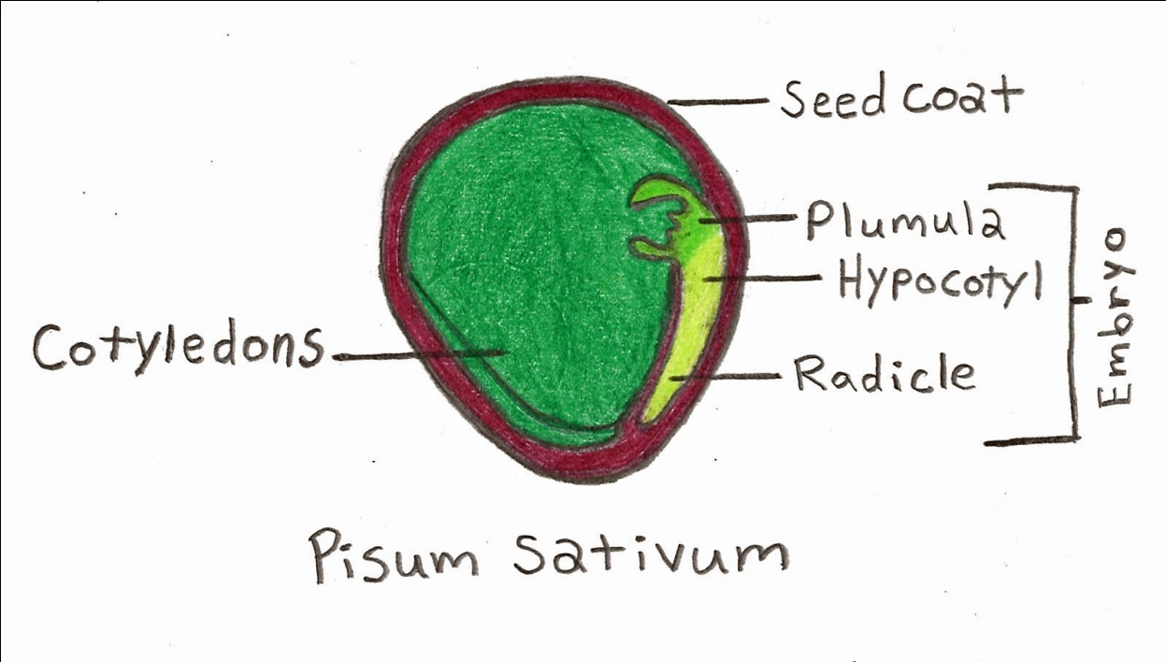
Non-Endospermic seeds:
They do not contain endosperm as it gets used by the developing embryo in the early stage. Instead the food is stored in the cotyledon
Example :- gram , pea, bean

Slide 9
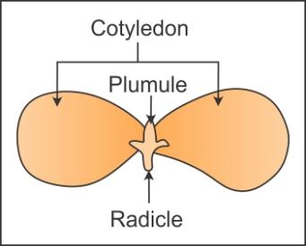
2. Based on the number of cotyledons
Dicotyledonous seeds: these have two cotyledons and far more in number than monocot seeds.
Example:- Gram, bean, pea ,mango

Slide 10
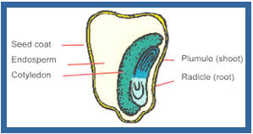
2. Monocotyledons seeds:
These have one cotyledon and are mostly endospermic.
Example:- Rice, maize , wheat

Slide 11
Significance of seeds
Seeds have better adaptive strategies for dispersal to new habitats.
It provides protection to the young embryo.
It contains food in them for young seedling.

Slide 12
Unusual features of sexual reproduction
Apomixis :-
It is the phenomenon of formation of new individuals without the involvement of fusion of gametes.
It is an abnormal kind of sexual reproduction in which egg develop into an embryo without fertilisation .
Example:- Species of Asteraceae and Grasses

Slide 13
Benefits of Apomixis
Rapid multiplication of genetically uniform individuals .
It can be useful in hybrid industry.
Resistance against pathogen
Increases reproduction efficiency

Slide 14
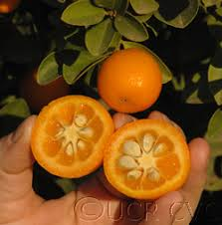
2. Polyembryony ( reported by Leewenhoek)
It refers to the occurance of more than one embryo in a seed.
Example:- orange, lemon, onion, groundnut

