Slide 1
SEXUAL REPRODUCTION IN FLOWERING PLANTS
-BIOLOGY

Slide 2
TOPIC
DEVELOPMENT OF AN EMBRYO IN DICOT.
FRUITS:- (SIGNIFICANCE,TYPES)

Slide 3
DEVELOPMENT OF AN EMBRYO

Slide 4
Description
The small daughter cell with dense cytoplasm is situated towards the chalazal pole side. It is called terminal cell/apical cell/embryonal cell.
Larger daughter cell situated towards the micropylar end is called basal cell.
This cells divides tranversely and give rise to suspensor cells.
The zygote further give rise to the proembryo and subsequently to the globular,heart-shaped and mature embryo.

Slide 5
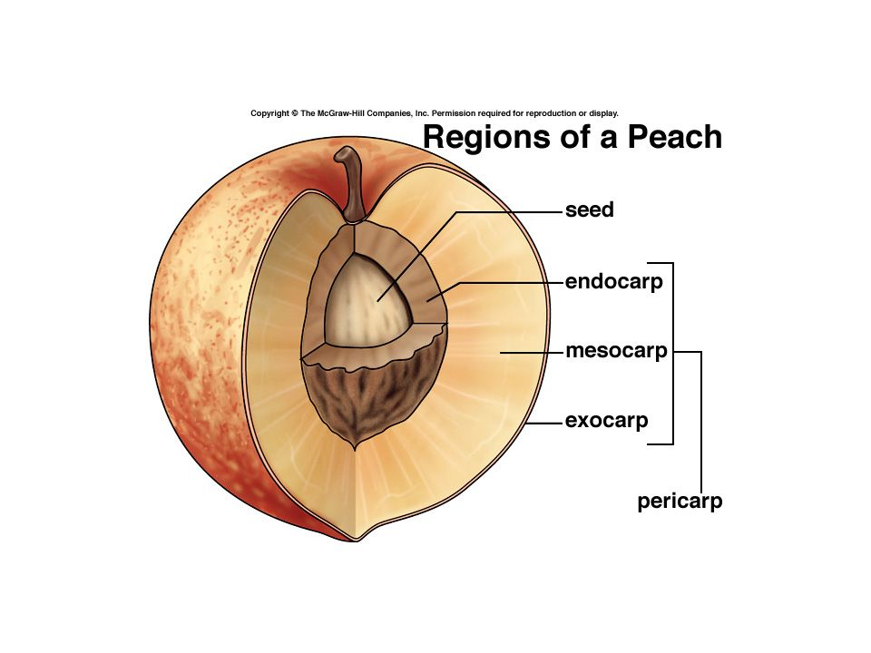
Fruits
Fruits are the mature or ripened ovary developed after fertlisation,containing seed inside them.
Fruit wall developed from ovary wall is differentiated into 3 regions:
Epicarp/Exocarp
Mesocarp
Endocarp

Slide 7
Types of fruits
True fruits
False fruits
Parthenocarpic fruit

Slide 8
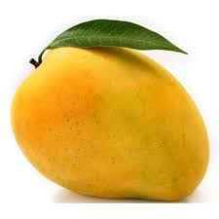
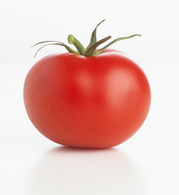
True fruits
The fruit derived from ovary of a flower not associated with any non carpellary part is termed as true fruit
Eg- mango and tomato

Slide 9
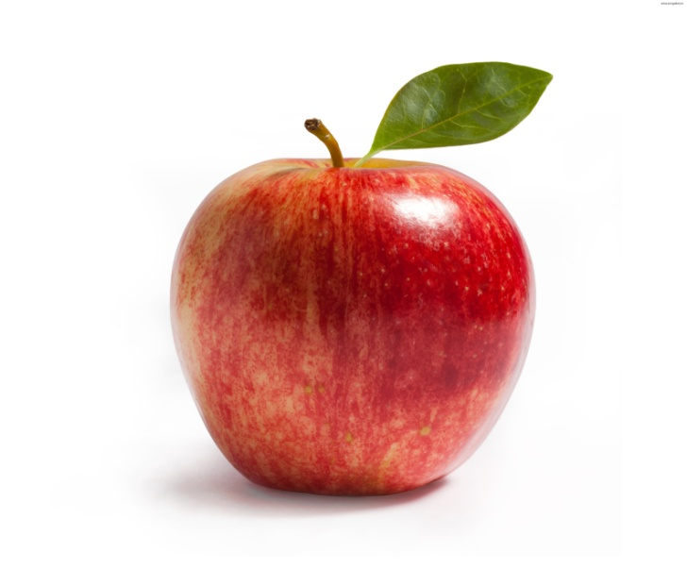
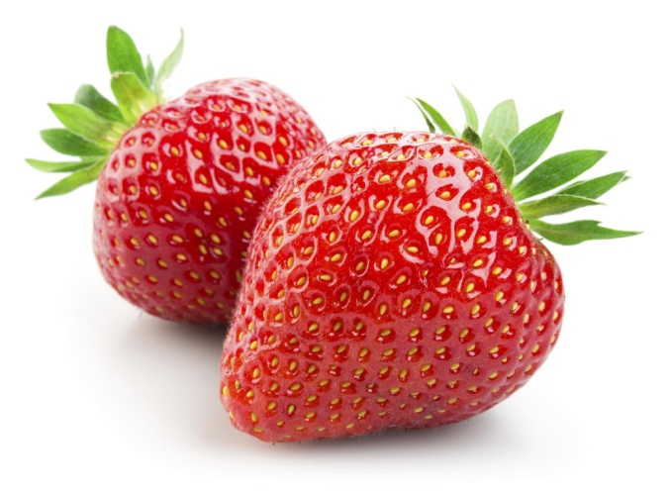
False fruit
The fruit derived from the ovary along with other accessory floral part like thalamus,receptacle is called false fruit.
Example:- apple,strawberry

Slide 10
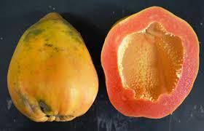
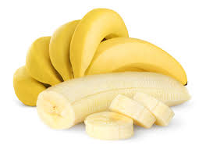
Parthenocarpic fruit (2012)
Some fruits develop without undergoing fertilisation ,these are called parthenocarpic fruits.
Example :- banana ,grapes , watermelon ,cucumber

Slide 11
Parthenocarpy (2008):- the process of formation of fruit without fertilization in plant is parthenocarpy

Slide 12
Significance
They are a source of food energy for animals.
They are a source of many chemicals like sugars, pectin, organic acids, vitamins and minerals .
The fruits protect the seeds from unfavourable climate conditions and animals.
Both fleshy and dry fruits help in the dispersal of seeds to distant places.
Provide nutrition to the developing seedling.

